Slide 1


Slide 2
What Causes Stress?
Survival
Survival/Health
Internal
No Control
Fatigue
Builds up over a long period of time
Environmental
Conditions around
Pressure
Unpleasant Event
Challenge
Fight or Flight
Adrenaline Rush
Tensions
Approach to Life
Behavioral Issues
Relationships
Events & Pressures at work
Distractions
Too much – too soon
Ineffective Time Management

Slide 3
Stress Stats
Regularly experience physical symptoms caused by stress
Regularly experience psychological symptoms caused by stress
Live with “Extreme” stress
Drugs prescribed in the United States for the treatment of stress
Stress has increased over the past five years
77%
73%
33%
48%
25%
Sources: Statistic Brain Research Institute, American Institute of Stress, NY
http://www.statisticbrain.com/stress-statistics/

Slide 4
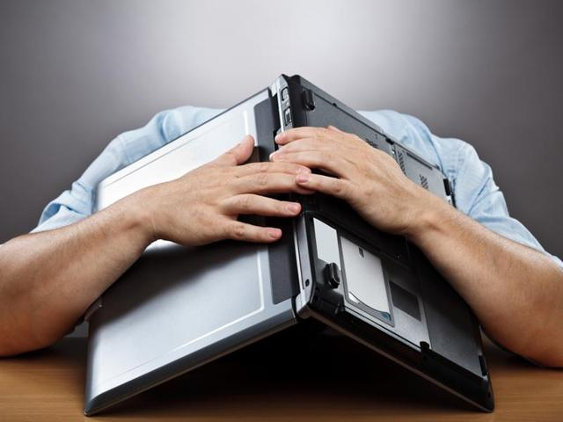
IMPACT
Personal:
Physical- Raised blood pressure/cardiovascular disease, Sleep disturbances, Headaches, Gastrointestinal upset
Intellectual- Loss of concentration and memory, Lack of motivation, Difficulty with thought process, Poor decision-making
Behavioral- Substance(including alcohol) misuse, Decreased libido, Isolation, Unpunctuality, Inappropriate display of behavior
Organizational:
High absenteeism and labor turnover
Poor performance, productivity and time keeping
Low morale
Increased employee complaints, ill-health, accidents and incidents reports

Slide 5
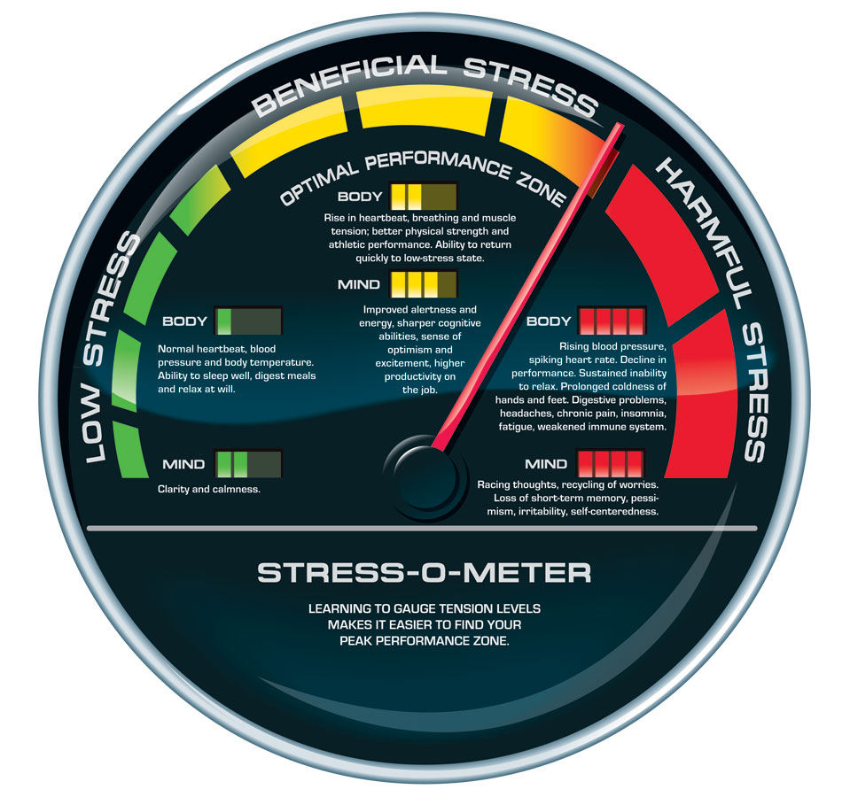
Anything Good about Stress?
Good
Bad
Source:
When Stress is Good for You
Wall Street Journal

Slide 6

D
i
stress
e
https://www.youtube.com/watch?v=M-V9q5ZemS0

